Slide 1
Processor Datapath

Slide 2
Introduction
MIPS ISA
3 Instruction Types
R-type, I-type, J-type
Datapath and Control Unit
Simplified
Pipelined
Simple subset
Memory reference: lw, sw
Arithmetic/logical: add, addi, sub, and, or, slt
Control transfer: beq, j

Slide 3
Instruction Format Review
Three instruction formats
R-type
I-type
J-type
Fields:
op: operation of the instruction
rs, rt, rd: source/destination register specifiers
shamt: shift amount
funct: selects variant of the operation in the “op” field
address/immediate: address offset or immediate value
target address: target address of the jump instruction
31
26
21
16
11
6
0
op
rs
rt
rd
shamt
funct
6 bits
5 bits
5 bits
5 bits
5 bits
6 bits
31
26
21
16
0
op
rs
rt
immediate
6 bits
5 bits
5 bits
16 bits
31
26
0
op
target address
6 bits
26 bits

Slide 4
MIPS Subset
Add, Subtract, AND, OR, SLT
add rd, rs, rt
sub rd, rs, rt
and rd, rs, rt
or rd, rs, rt
slt rd, rs, rt
ADD Immediate
addi rt, rs, imm16
Load, Store
lw rt, rs, imm16
sw rt, rs, imm16
BRANCH
beq rs, rt, imm16
JUMP:
j target
31
26
21
16
11
6
0
op
rs
rt
rd
shamt
funct
6 bits
5 bits
5 bits
5 bits
5 bits
6 bits
31
26
21
16
0
op
rs
rt
immediate
6 bits
5 bits
5 bits
16 bits
31
26
0
op
target address
6 bits
26 bits

Slide 5
Instruction Execution
For every instruction:
Send the program counter (PC) to the memory that contains the code and fetch the instruction from that memory.
Read one or two registers, using fields of the instruction to select the registers to read. For the load word instruction, we need to read only one register, but most other instructions require that we read two registers.

Slide 6
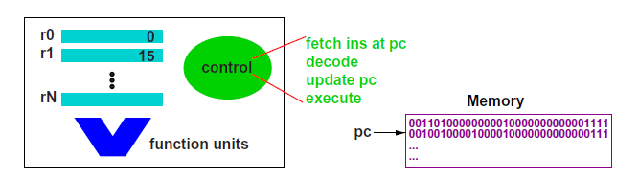
Instruction Execution
Fetch:
Get the next instruction: stored at PC

Slide 7
Instruction Execution
Decode:
Opcode determines if the instruction is arithmetic/logical, memory logical, or branch.

Slide 8
Instruction Execution
Update PC: PC ← target address or PC + 4
If the instruction is a branch, we have to calculate the target address
If the instruction is not a branch, the new PC will be PC + 4

Slide 9
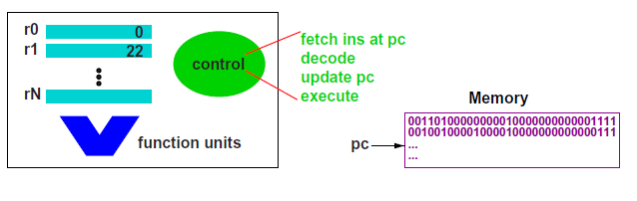
Instruction Execution
Update PC: PC ← target address or PC + 4
If the instruction is a branch, we have to calculate the target address
If the instruction is not a branch, the new PC will be PC + 4

Slide 10
Instruction Execution
Execute:
Depending on instruction class, we use the ALU to calculate:
Arithmetic result
Memory address for load/store
Branch target address

Slide 11
Instruction Execution
To read and write registers, we need a register file
R-types read two registers and write one register
Memory-reference instructions read one register
Also access data memory

Slide 12
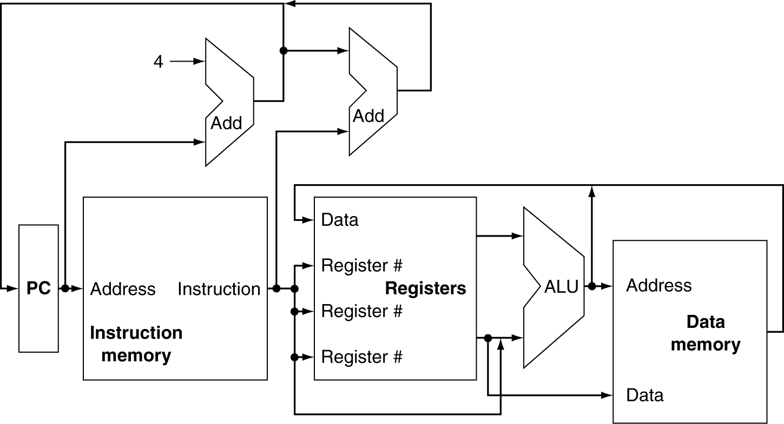
Processor Overview
Data “flows” through memory and functional units

Slide 13
Processor Overview
Can’t just join wires together
Use multiplexers

Slide 14
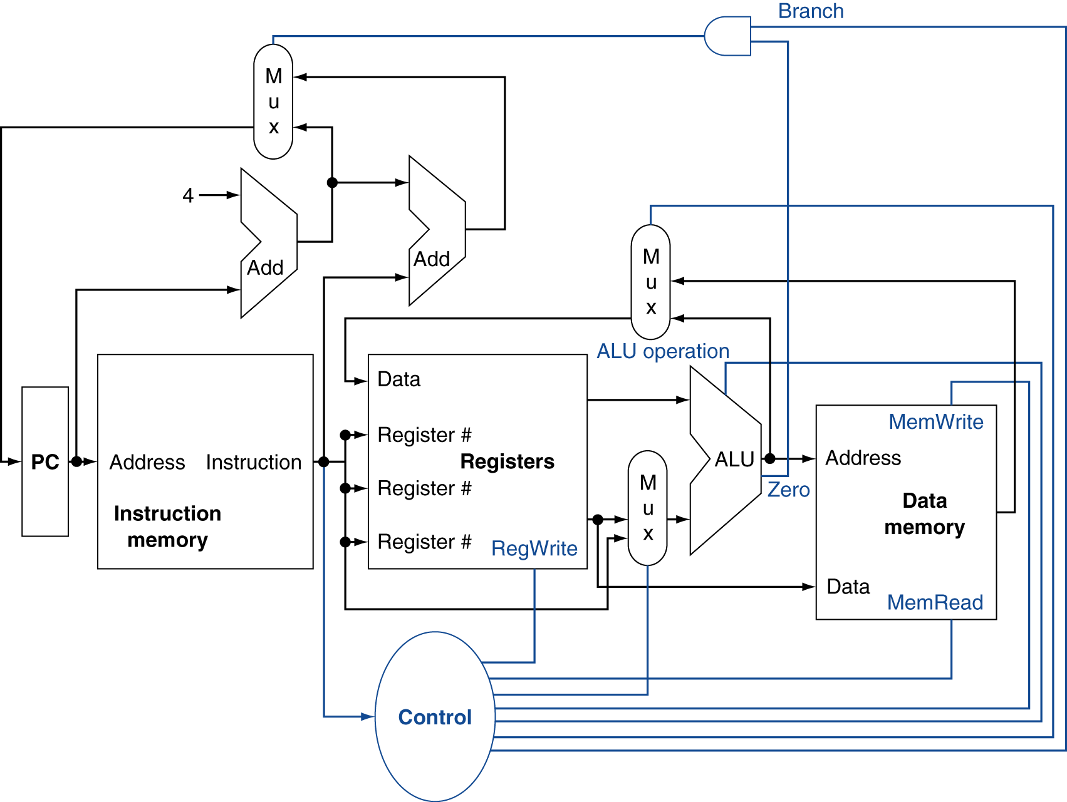
Processor Overview
Multiplexers require selection signals
Control Signals

Slide 15
Signals
Information encoded in binary
Low voltage = 0, High voltage = 1
One wire per bit
Multi-bit data encoded on multi-wire buses

Slide 16
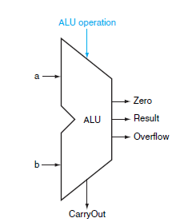
Logic Design Review
Combinational Circuits
Output depends only on current input
Operate on data
Example: ALU
Given the same input a combinational circuit will always produce the same output

Slide 17
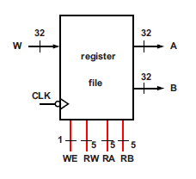
Logic Design Review
Sequential Circuits
Have “state”
Output depends on current input and previous outputs
Example: Register File
State elements have at least two inputs: input and clock

Slide 18
MIPS Register File
32 32-bit registers
One write bus
Two read buses
Selection Inputs
Write Enable
Reg. Write
Reg. Read A
Reg. Read B

Slide 19
Timing Review
Edge-Triggered Clocking Methodology
The clock determines when actions can take place.
Updates can only occur on the clock edge.

Slide 20
Write Control Signals
Every Clock Cycle
When Necessary
We do not show a write control signal when a state element is written on every active clock edge.
Program Counter
If a state element is not updated on every clock, then an explicit write control signal is required.
Register File

Slide 21
Datapath Elements
Most elements have 32-bit wide inputs and outputs
Buses labeled with their width

Slide 22
Datapath Elements - Combinational
Adder
Y = A + B
A
+
Y
B
Multiplexer
Y = S ? I1 : I0
I0
M u x
Arithmetic/Logic Unit
Y = F(A, B)
Y
I1
S
A
ALU
Y
B
F

Slide 23
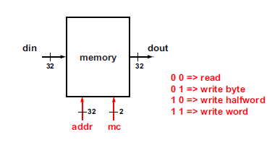
Datapath Elements - Sequential

Slide 24
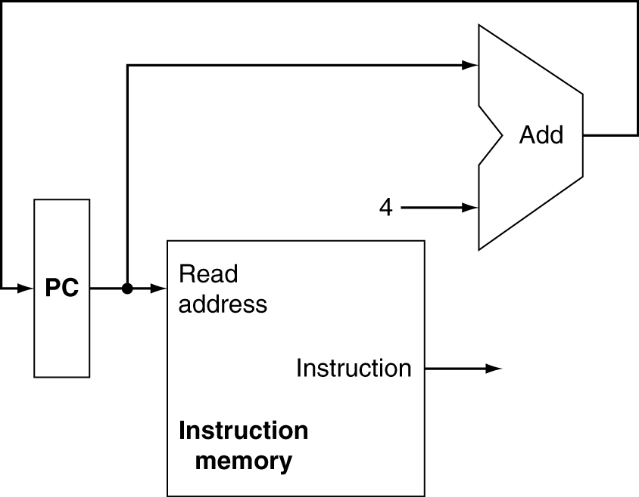
Fetch Elements
Memory Unit
Program Counter
Adder

Slide 25
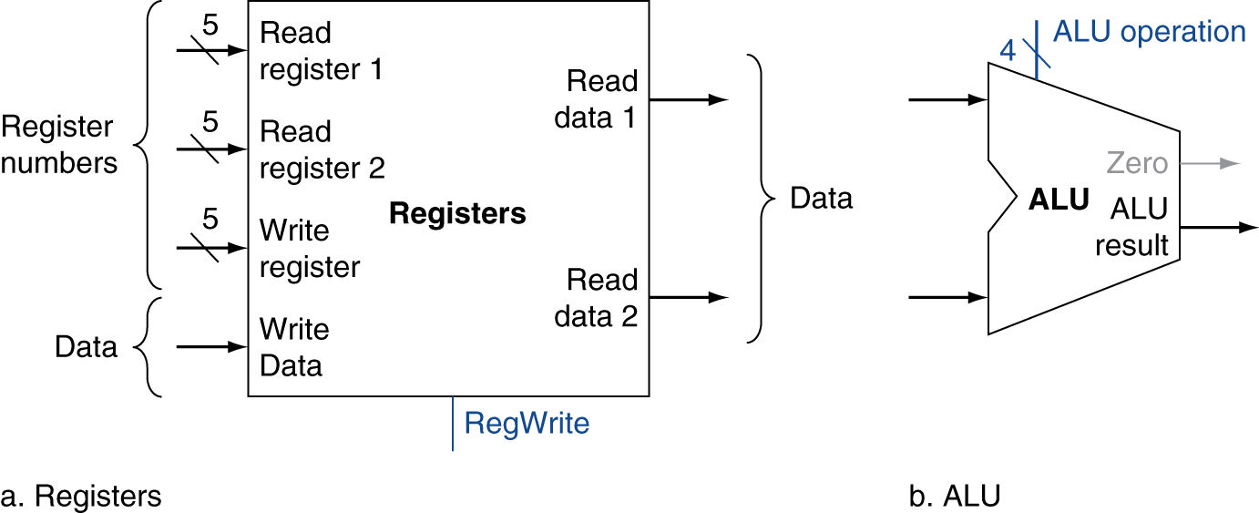
R-Type Instructions
Read two register operands
Perform arithmetic/logical operation
Write register result

Slide 26
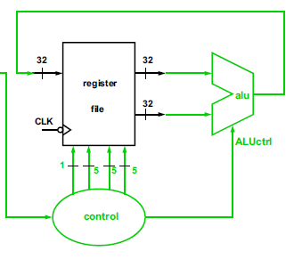
R-Type Instructions
add $t1, $t2, $t3
RW = 9
RA = 10
RB = 11
ALUctrl = “add”

Slide 27
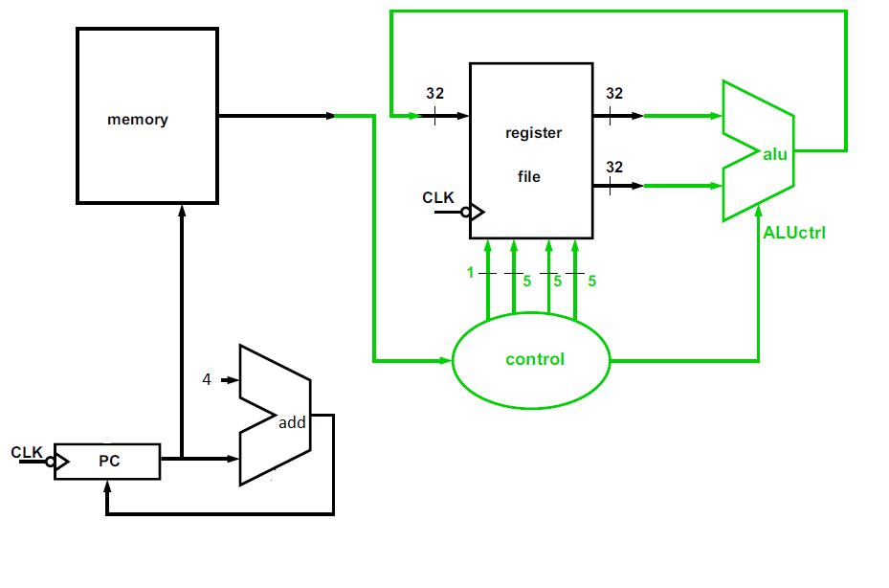
Datapath: R-Type Instructions

Slide 28
I-Type Instructions
Replace one read register, shamt, and funct with 16 bit constant
ALU requires 32-bit inputs
Sign-extend the 16 bit immediate
Fill with 0s if the constant is positive
Fill with 1s if the constant is negative
Choose between the second read registers and the sign extended constant.

Slide 29
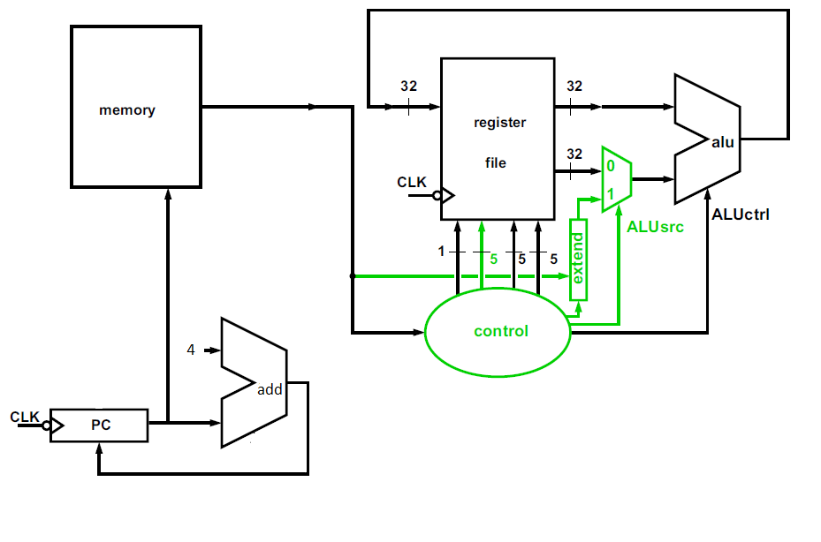
Datapath: I-Type Instructions

Slide 30
Load/Store Instructions
lw $t1, offset($t2)
sw $t1, offset($t2)
Compute memory address: $t2 + offset
Since offset is 16 bits, it needs to be extended to 32 bits

Slide 31
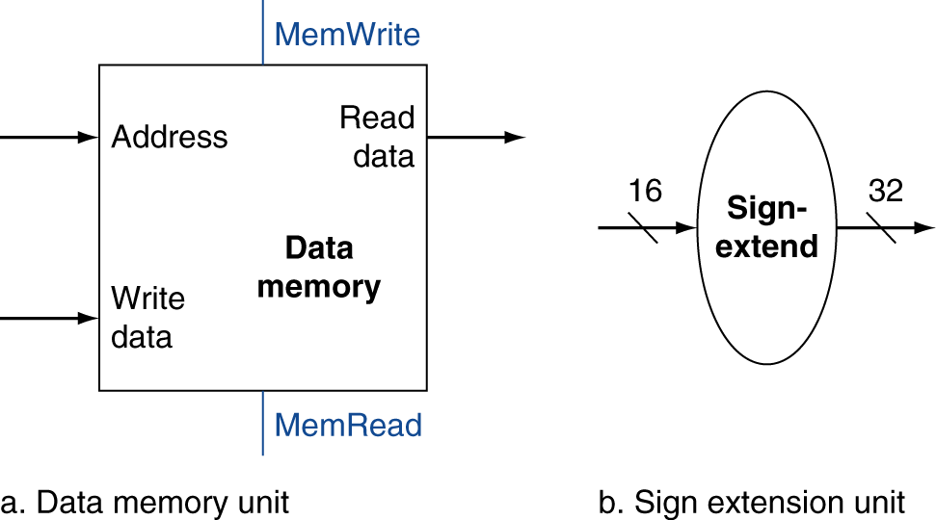
Load/Store Instructions
Load: Read memory and update register
Store: Write register value to memory
Elements:
Register file
Sign extension unit
Data memory unit

Slide 32
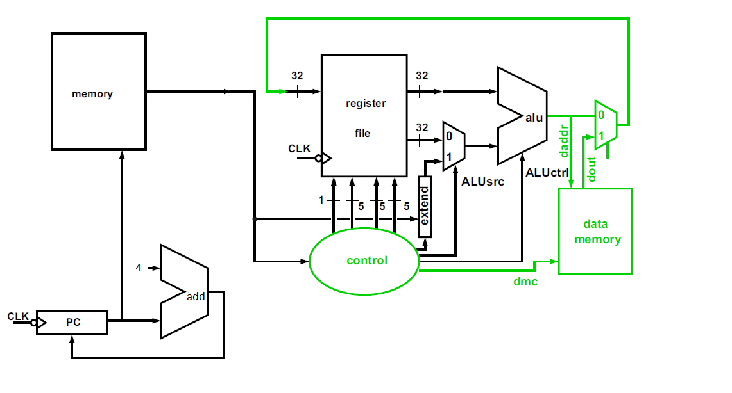
Datapath: Load Instruction

Slide 33
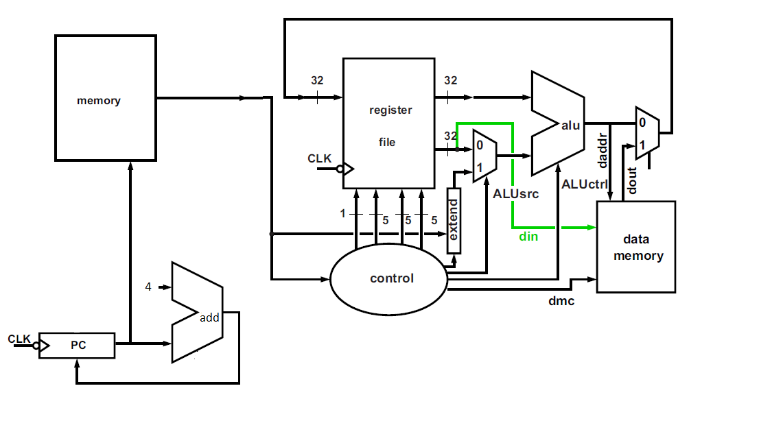
Datapath: Store Instruction

Slide 34
Branch Instructions
beq $t1, $t2, offset
Read register operands
Compare operands
Use ALU, subtract and check Zero output
Calculate target address
Sign-extend displacement
Shift left 2 places (word displacement)
Add to PC + 4
Already calculated by instruction fetch

Slide 35
Target Address Details
The base for the branch address calculation is the address of the instruction following the branch.
PC+4
Memory is byte addressed
The offset field must be shifted left 2 bits

Slide 36
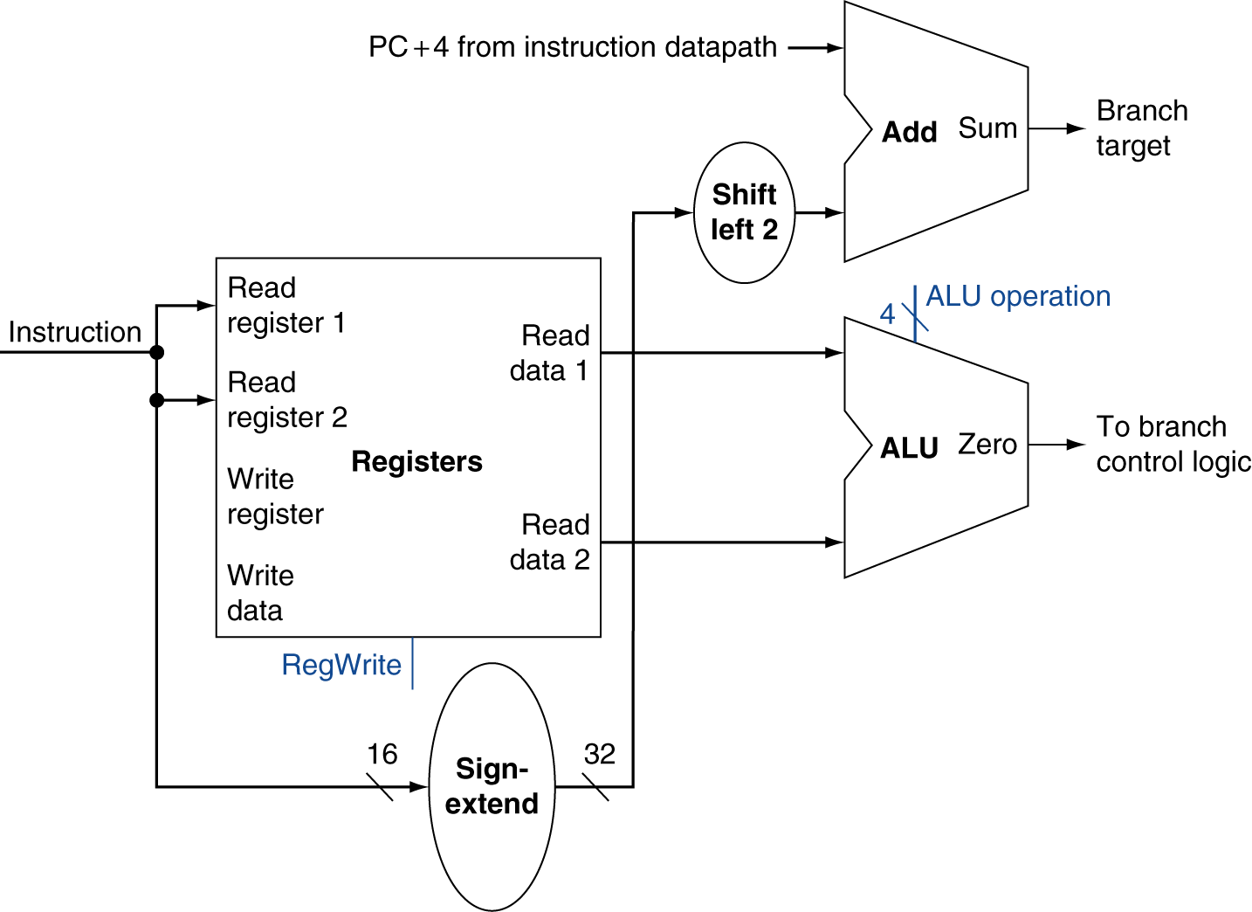
Branch Instructions
Just re-routes wires
Sign-bit wire replicated

Slide 37
Branching
beq $t1, $t2, offset
Branch is taken
When $t1 - $t2 = 0, the zero signal from the ALU
PC = PC + 4 + 4*offset
Branch is not taken
PC = PC + 4

Slide 38
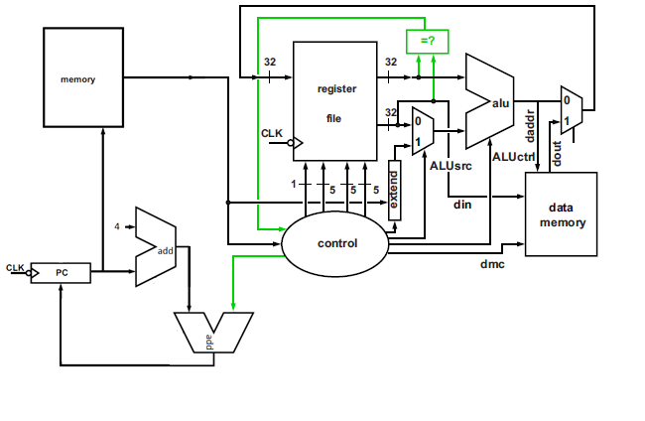
Datapath: Branch

Slide 39
Jump Instructions
PC = PC[31-28] : Offset << 2

Slide 40
Single Datapath
All instructions executed in one clock cycle
Each datapath element can only do one function at a time
Any element needed more than once must be duplicated
Hence, we need separate instruction and data memories
Use multiplexers where alternate data sources are used for different instructions

Slide 41
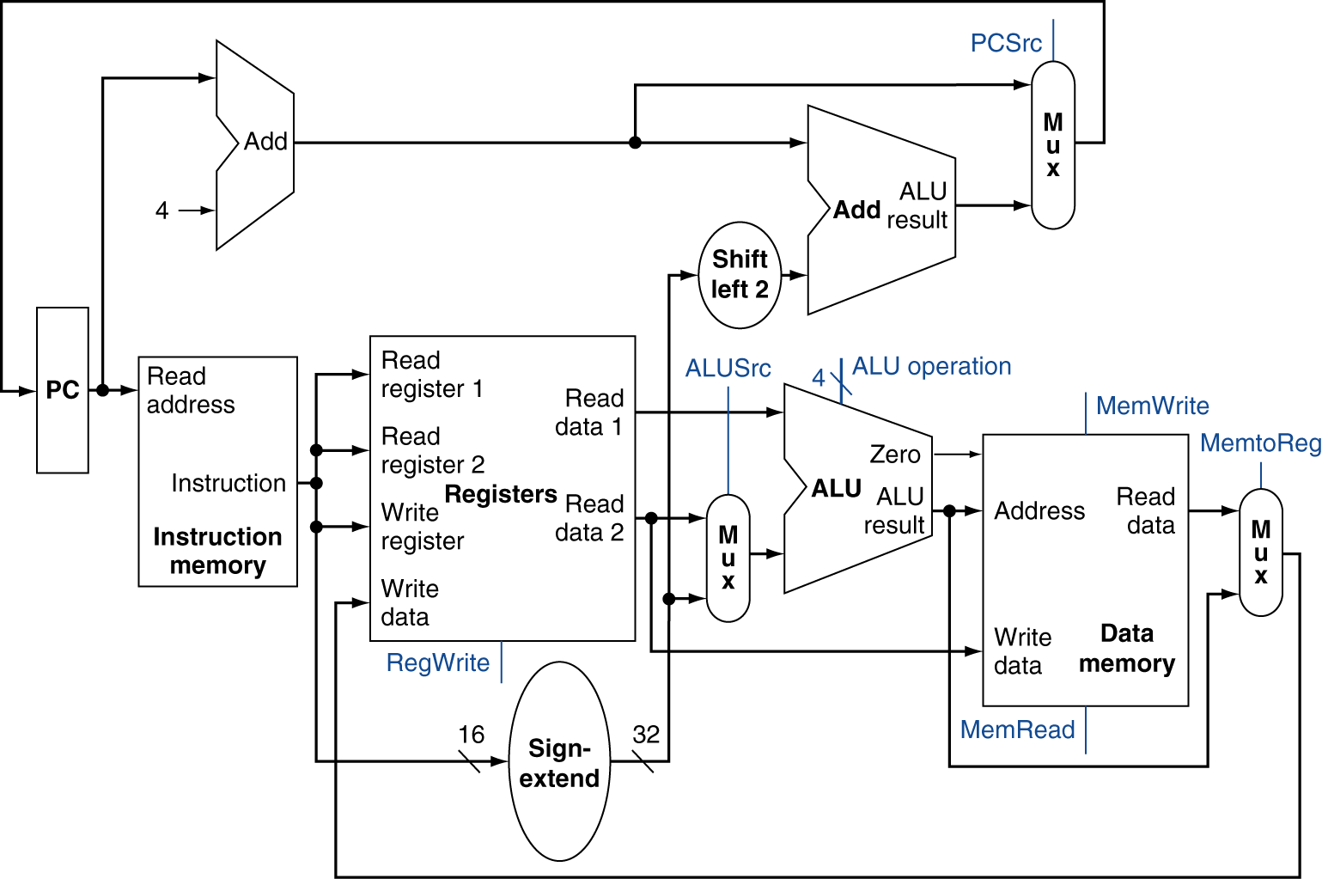
Datapath

Slide 42
Control Unit
Take in input
Generate signals for each state element
Generate selection signals for each multiplexor
Generate function signals for ALU
ALU Control

Slide 43
ALU Control
MIPS subset: lw, sw, beq, add, addi, sub, and, or, slt
ALU has 4 control inputs
16 possible functions
ALU Control | Function
0000 | AND
0001 | OR
0010 | Add
0110 | Subtract
0111 | Set-on-less-than
1100 | NOR

Slide 44
ALU Control
Load/Store: add
Branch: subtract
R-type: depends on funct field
ALU Control | Function
0000 | AND
0001 | OR
0010 | Add
0110 | Subtract
0111 | Set-on-less-than
1100 | NOR

Slide 45
ALU Control
Opcode determines which type of instruction
The ALUOp is a 2-bit signal derived from this Opcode
ALUOp and the funct field will determine ALU control
Opcode | ALUOp | Operation | Funct | ALU function | ALU Control
Lw | 00 | Load word | XXXXXX | Add | 0010
Sw | 00 | Store word | XXXXXX | Add | 0010
Beq | 01 | Branch | XXXXXX | Subtract | 0110
R-type | 10 | Add | 100000 | Add | 0010
 |  | Subtract | 100010 | Subtract | 0110
 |  | AND | 100100 | AND | 0000
 |  | OR | 100101 | OR | 0001
 |  | Set-on-Less-Than | 101010 | Set-on-Less-Than | 0111

Slide 46
ALU Control
Multiple levels of decoding:
Main Control generates ALUOp
ALUOp and funct bits determine ALU Control

Slide 47
ALU Control
ALUOp and funct bits determine ALU Control
ALUOp1 | ALUOp2 | Funct |  |  |  |  |  | Operation
0 | 0 | X | X | X | X | X | X | 0010 (add)
X | 1 | X | X | X | X | X | X | 0110 (subtract)
1 | X | X | X | 0 | 0 | 0 | 0 | 0010 (add)
1 | X | X | X | 0 | 0 | 1 | 0 | 0110 (subtract)
1 | X | X | X | 0 | 1 | 0 | 0 | 0000 (and)
1 | X | X | X | 0 | 1 | 0 | 1 | 0001 (or)
1 | X | X | X | 1 | 0 | 1 | 0 | 0111 (slt)

Slide 48
The Main Control Unit
Control signals derived from instruction
R-type
0
rs
rt
rd
shamt
funct
31:26
25:21
20:16
15:11
10:6
5:0
Load/ Store
35 or 43
rs
rt
address
31:26
25:21
20:16
15:0
Branch
4
rs
rt
address
31:26
25:21
20:16
15:0
opcode
always read
read, except for load
write for R-type and load
sign-extend and add

Slide 49
Main Control Unit
Observations
The opcode is always contained in bits 31:26. We will refer to this field as Op[5:0].
The two registers to be read are always specified by the rs and rt fields, at positions 25:21 and 20:16. This is true for the R-type instructions, branch equal, and for store.
The base register for load and store instructions is always in bit positions 25:21 (rs).
The 16-bit offset for branch equal, load, and store is always in positions 15:0.
The destination register is in one of two places.
For a load it is in bit positions 20:16 (rt)
For an R-type instruction it is in bit positions 15:11 (rd)
We will need to add a multiplexor to select which field of the instruction is used to indicate the register number to be written.

Slide 50
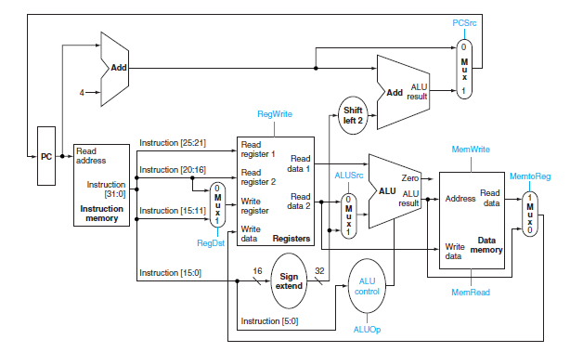
Datapath with ALU Control

Slide 51
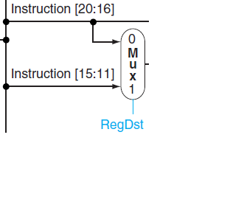
Control Signals – Register Destination
RegDst
Deasserted: the register destination number for the write register comes the rt field (bits 20:16)
Asserted: the register destination number for the write register comes the rd field (bits 15:11)

Slide 52
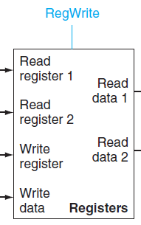
Control Signals – Register Write
RegWrite
Asserted: the register destination on the write register input is written with the value on the write data input

Slide 53
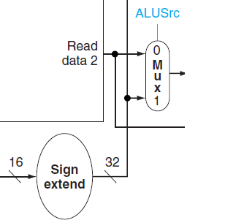
Control Signals – ALU Source
ALUSrc
Deasserted: The second ALU operand comes from the second register file output
Asserted: The second ALU operand is the sign-extended lower 16 bits of the instruction

Slide 54
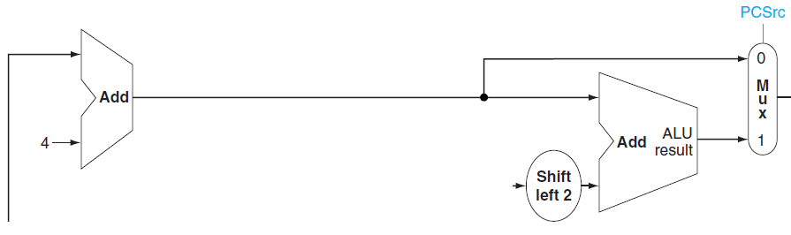
Control Signals - PCSrc
Program Counter Source
Deasserted: The PC is replaced by PC + 4
Asserted: The PC is replaced by a branch target address

Slide 55
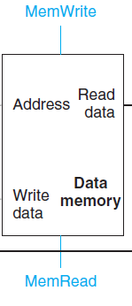
Control Signals – Memory Read
MemRead
Asserted: Data memory contents designated by the address input are put on the read data output.

Slide 56
Control Signals – Memory Write
MemWrite
Asserted: Data memory contents designated by the address input are replaced by the value on the write data input.

Slide 57
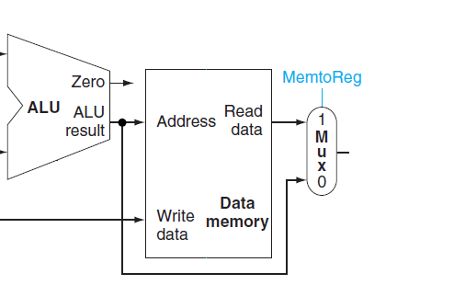
Control Signals – Memory to Register
MemtoReg
Deasserted: The value fed to the register write data input comes from the ALU
Asserted: The value fed to the register write data input comes from the data memory.

Slide 58
Control Signals
All but one signal can be set based only on the opcode
PCSrc is the exception
Relies on the result of a branch
PCSrc should be set if the instruction is beq and the zero output of the ALU is asserted

Slide 59
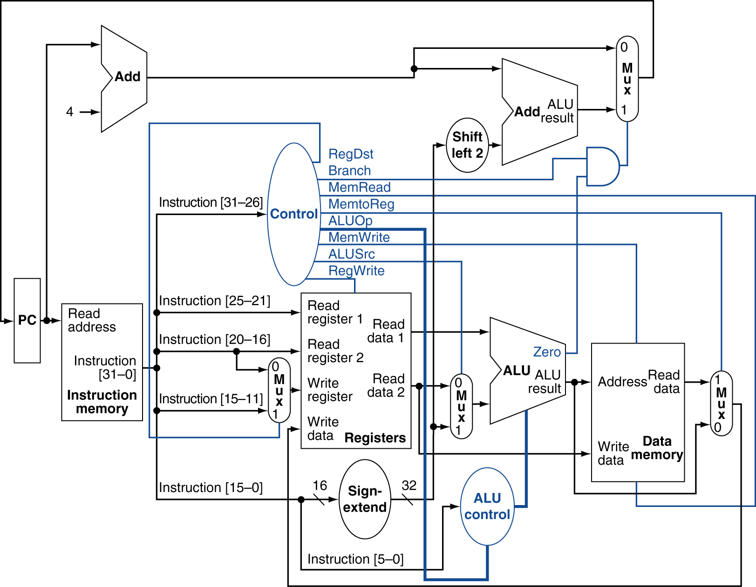
Datapath With Control

Slide 60
Opcode to Control
Instruction | RegDst | ALUSrc | MemtoReg | RegWrite
R-Format | 1 | 0 | 0 | 1
Lw | 0 | 1 | 1 | 1
Sw | X | 1 | X | 0
Beq | X | 0 | X | 0
Instruction | MemRead | MemWrite | Branch | ALUOp1 | ALUOp0
R-Format | 0 | 0 | 0 | 1 | 0
Lw | 1 | 0 | 0 | 0 | 0
Sw | 0 | 1 | 0 | 0 | 0
Beq | 0 | 0 | 1 | 0 | 1

Slide 61
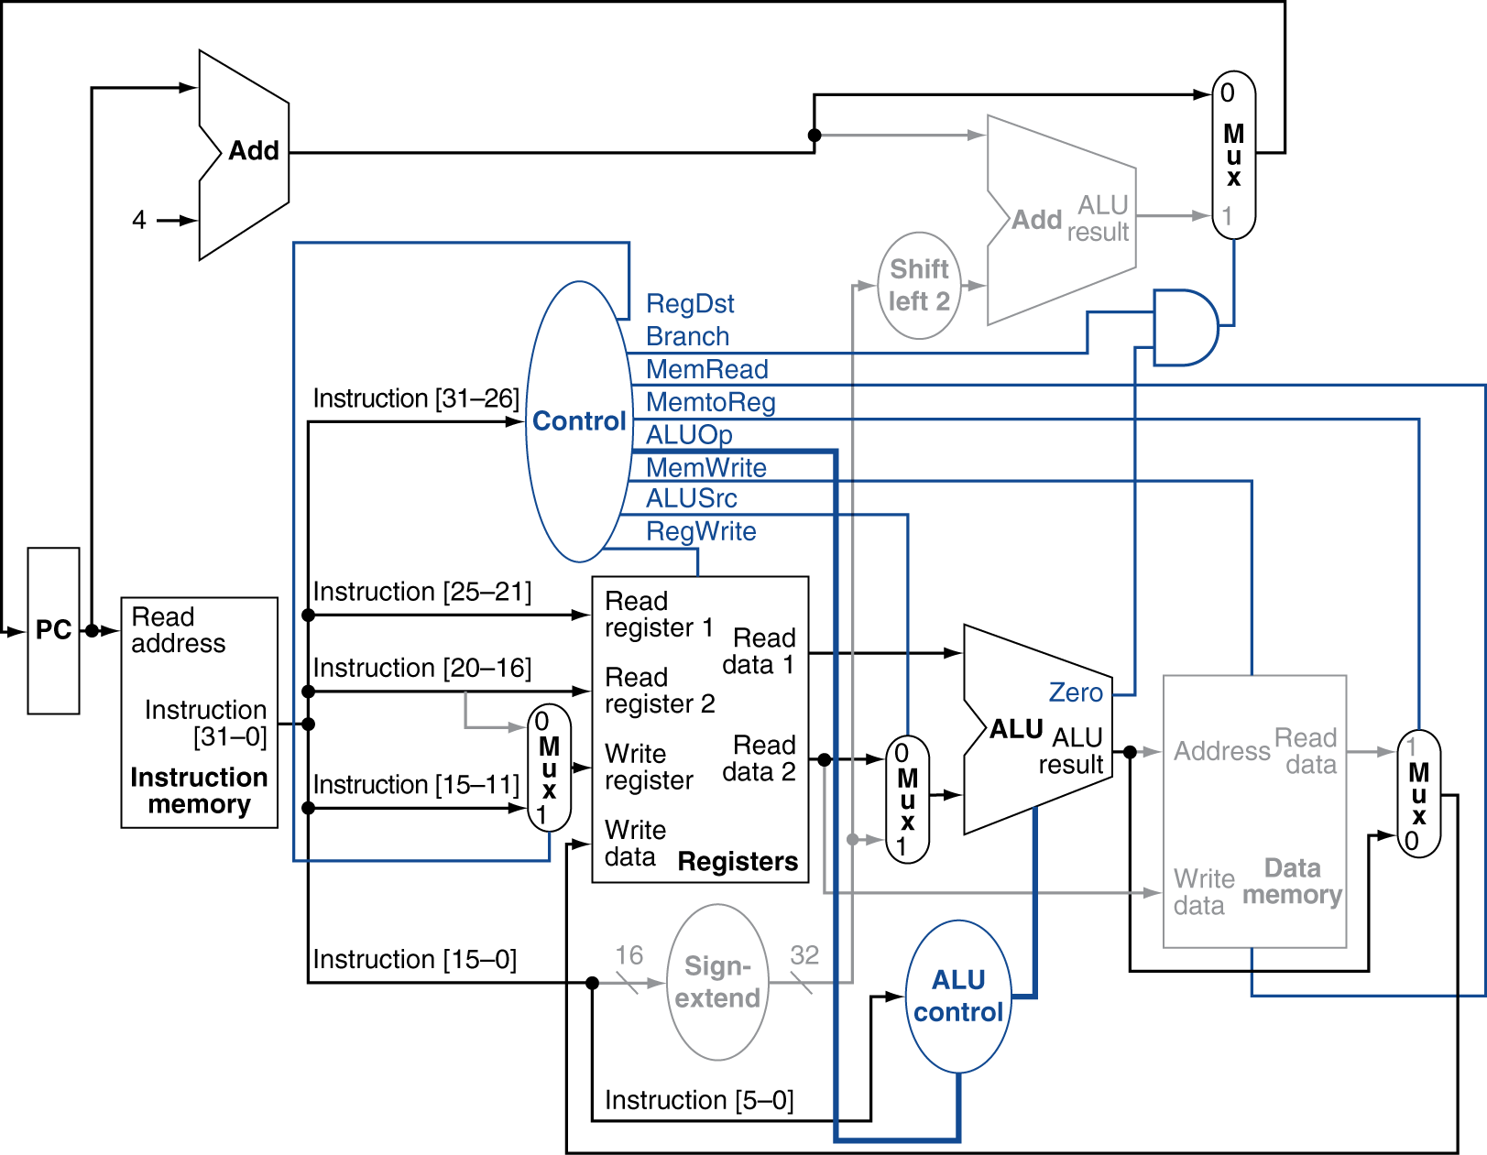
R-Type Instruction

Slide 62
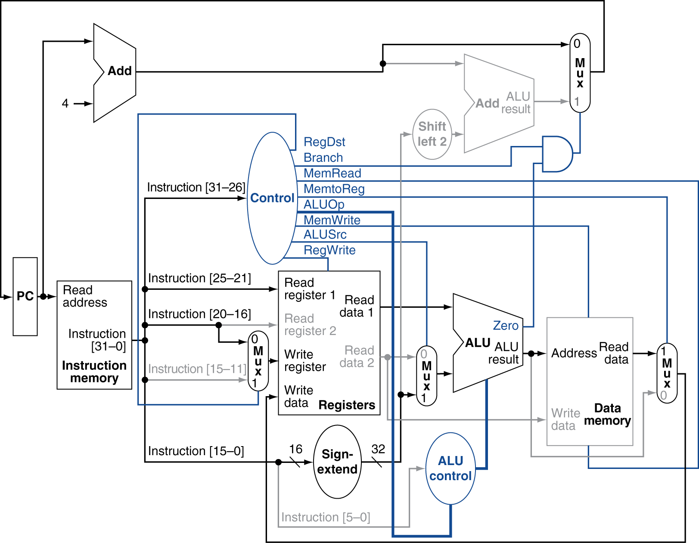
Load Instruction

Slide 63
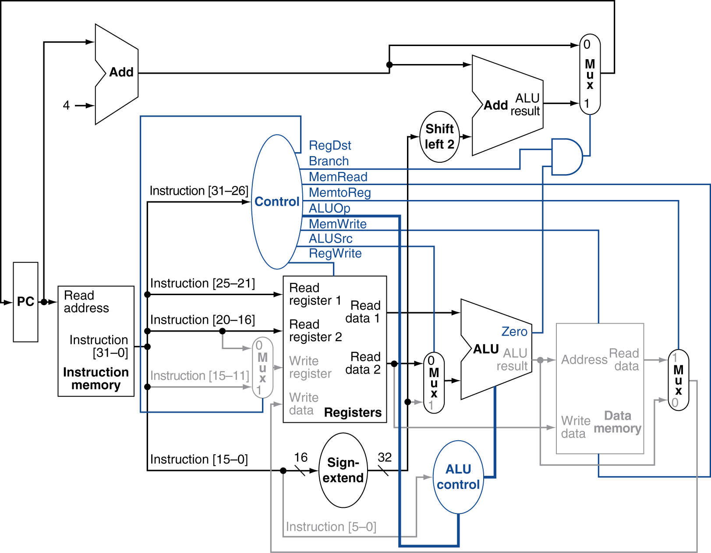
Branch-on-Equal Instruction

Slide 64
Opcode to Control
In/Out | Signal | R-Format | Lw | Sw | Beq
Inputs | Op5 | 0 | 1 | 1 | 0
 | Op4 | 0 | 0 | 0 | 0
 | Op3 | 0 | 0 | 1 | 0
 | Op2 | 0 | 0 | 0 | 1
 | Op1 | 0 | 1 | 1 | 0
 | Op0 | 0 | 1 | 1 | 0
Outputs | RegDst | 1 | 0 | X | X
 | ALUSrc | 0 | 1 | 1 | 0
 | MemToReg | 0 | 1 | X | X
 | RegWrite | 1 | 1 | 0 | 0
 | MemRead | 0 | 1 | 0 | 0
 | MemWrite | 0 | 0 | 1 | 0
 | Branch | 0 | 0 | 0 | 1
 | ALUOp1 | 1 | 0 | 0 | 0
 | ALUOp0 | 0 | 0 | 0 | 1

Slide 65
Implementing Jumps
Jump uses word address
Update PC with concatenation of
Top 4 bits of old PC
26-bit jump address
00
Need an extra control signal decoded from opcode
Jump
2
address
31:26
25:0

Slide 66
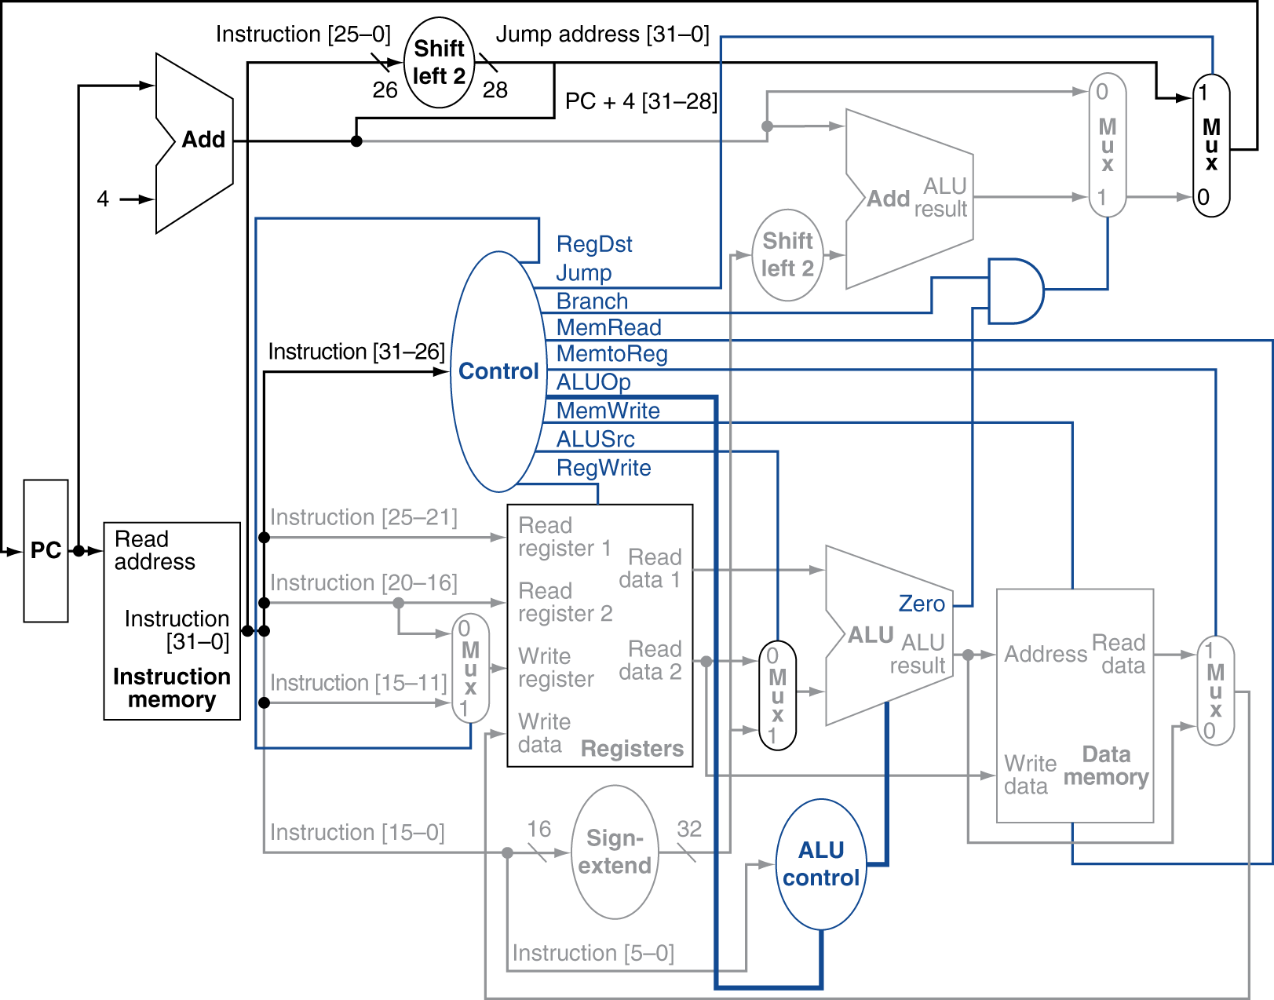
Datapath With Jumps Added

Slide 67
Single-Cycle Implementation
Every instruction begins execution on one clock edge and completes execution on the next clock edge.
Clock cycle time must be at least as long as the longest instruction (load word).
Cycle time =
PC’s propagation time +
Instruction Memory Access Time +
Register File Access Time +
ALU Delay (address calculation) +
Data Memory Access Time +
Register File Setup Time +
Clock Skew

Slide 68
Single-Cycle Implementation
Every instruction begins execution on one clock edge and completes execution on the next clock edge.
Clock cycle time must be at least as long as the longest instruction (load word).
The cycle time for load is much longer than any other instruction

Slide 69
Single-Cycle Implementation
Single-Cycle implementation is not practical
Unable to implement more complex instructions
Cannot make improves that will speed up the system unless those improvements are to load
Violates the design principle of making the common case fast
Some functional units must be duplicated, increasing hardware cost

Slide 70
Pipelining
Pipelining is an implementation technique in which multiple instructions are overlapped in execution.
Pipelining is nearly universal.

Slide 71
Analogy for Pipelining: Laundry
Nonpipelined approach:
Place one dirty load of clothes in the washer.
When the washer is finished, place the wet load in the dryer.
When the dryer is finished, place the dry load on a table and fold.
When folding is finished, put the clothes away.
When the clothes are put away, the next load can begin.

Slide 72
Analogy for Pipelining: Laundry
Pipelined approach:
Place one dirty load (load A) of clothes in the washer.
When the washer is finished, place load A in the dryer and start a new load (load B) in the washer.
When the dryer is finished, place load A on the table to fold, place load B in the dryer, and start a new load (load C) in the washer.
When folding is finished, put away load A, fold load B, place load C in the dryer, start load D in the washer.

Slide 73
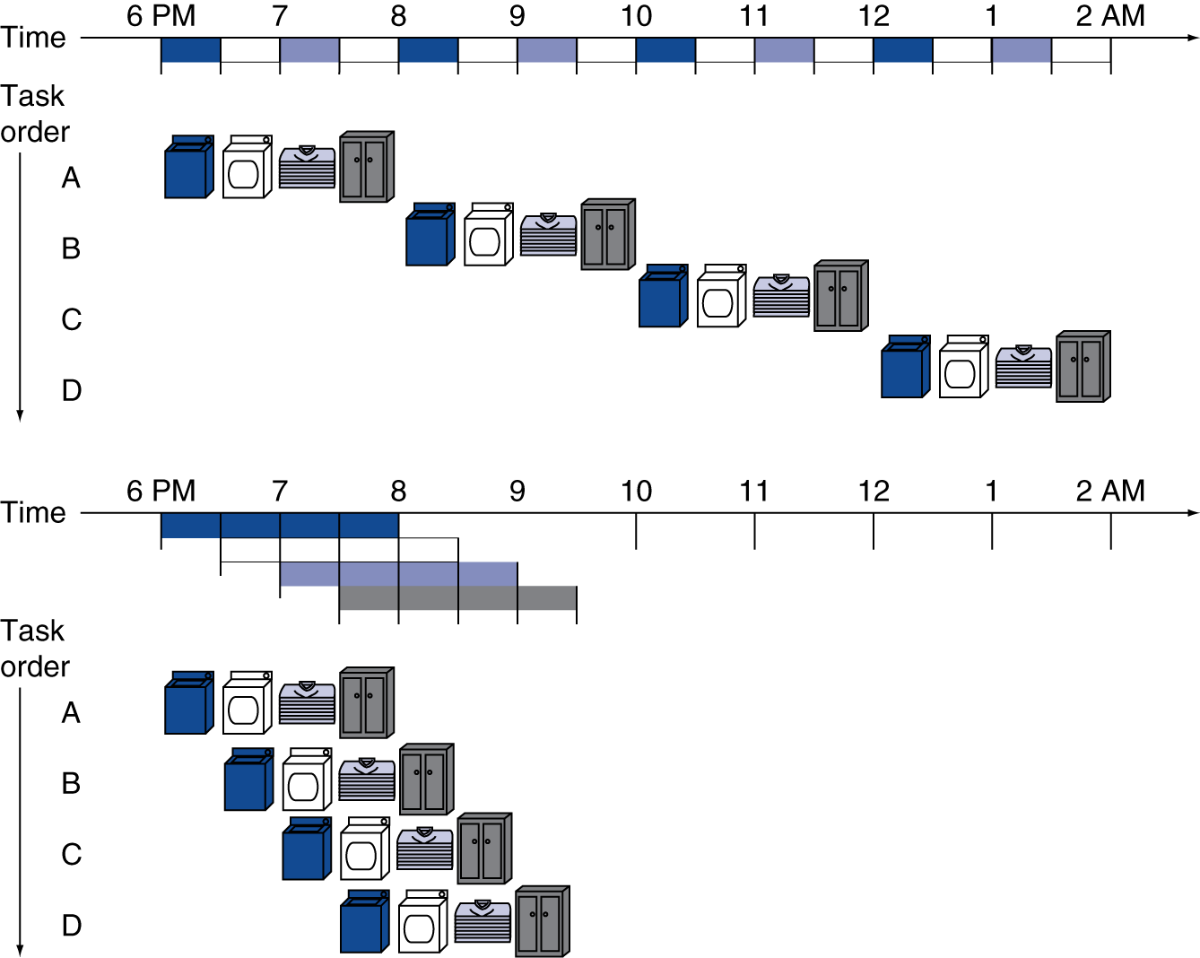
Analogy for Pipelining: Laundry

Slide 74
Pipelining Paradox
One load of laundry still takes the same amount of time.
The amount of time it takes to do many loads of laundry is shorter with pipelining.
Pipelining improves throughput.

Slide 75
Pipelining Speedup
If all the stages take about the same amount of time and there is enough work to do, then the speedup due to pipelining is roughly equal to the number of stages in the pipeline.
Laundry Analogy:
4 stages (washing, drying, folding, putting away)
20 loads pipelined would take about 5 times as long as 1 load
20 loads of sequential laundry takes 20 times as long as 1 load

Slide 76
MIPS Pipeline
Fetch instruction from memory.
Read registers while decoding the instruction.
Execute the operation or calculate an address.
Access an operand in data memory.
Write the result into a register.
Instruction Fetch (IF)
Instruction Decode (ID)
Execution (EX)
Memory Access (MEM)
Write Back (WB)

Slide 77
Pipeline Speedup
If all stages are balanced
i.e., all take the same time
Time between instructions_{pipelined} = Time between instructions_{nonpipelined} Number of stages
If not balanced, speedup is less
Speedup due to increased throughput
Latency (time for each instruction) does not decrease
Programs execute billions of instructions – throughput is important!

Slide 78
Pipelining and ISA Design
MIPS ISA designed for pipelining
All instructions are 32-bits
Easier to fetch and decode
Few and regular instruction formats
Can decode and read registers in one step
Load/store addressing
Can calculate address in 3rd stage, access memory in 4th stage
Alignment of memory operands
Memory access takes only one cycle

Slide 79
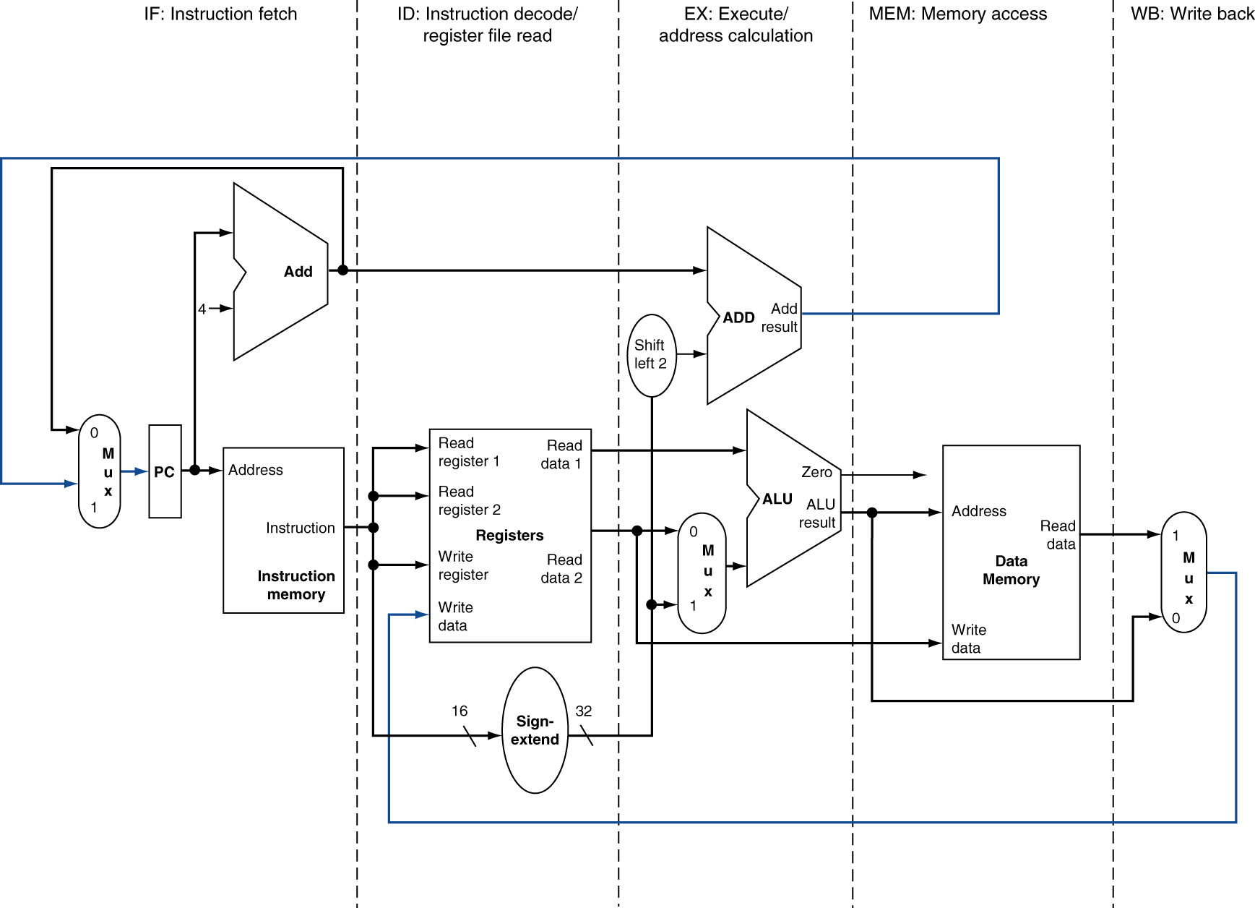
MIPS Pipelined Datapath
Branch
WB

Slide 80
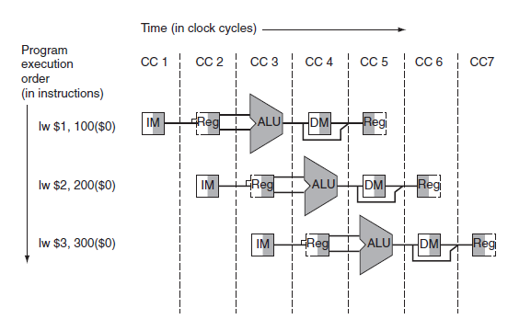
Pipelined Execution

Slide 81
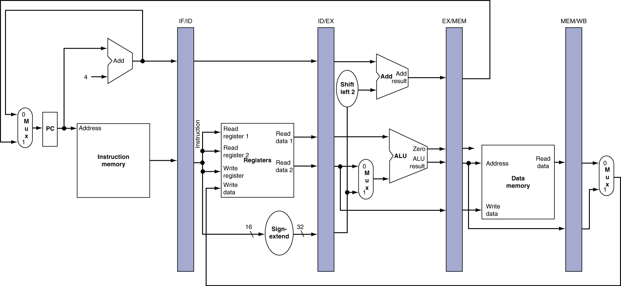
Pipeline registers
Need registers between stages
To hold information produced in previous cycle

Slide 82
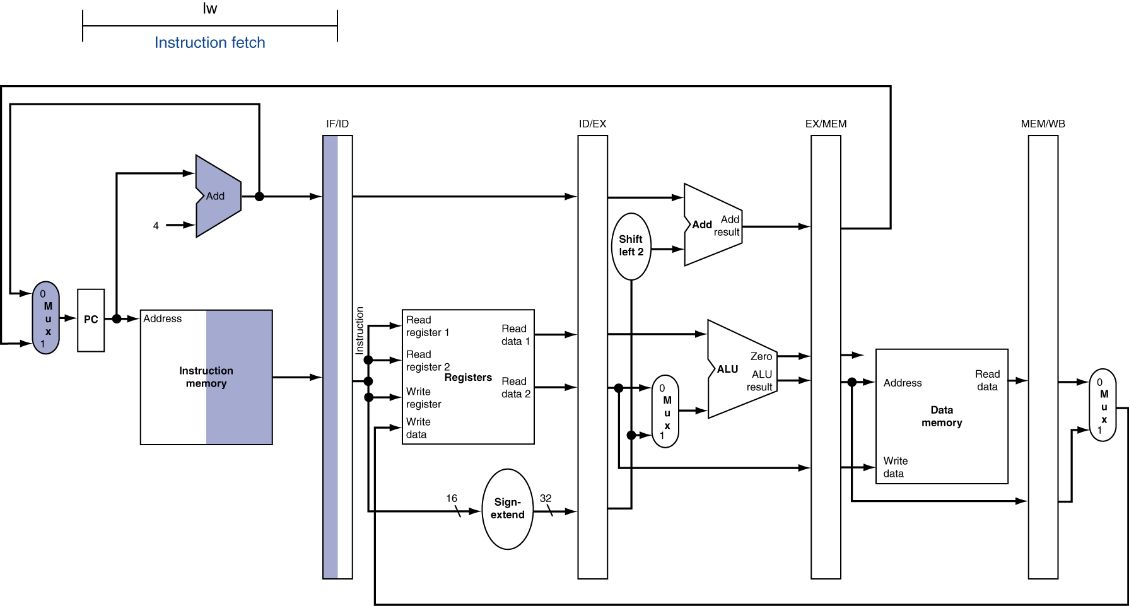
IF for Load

Slide 83
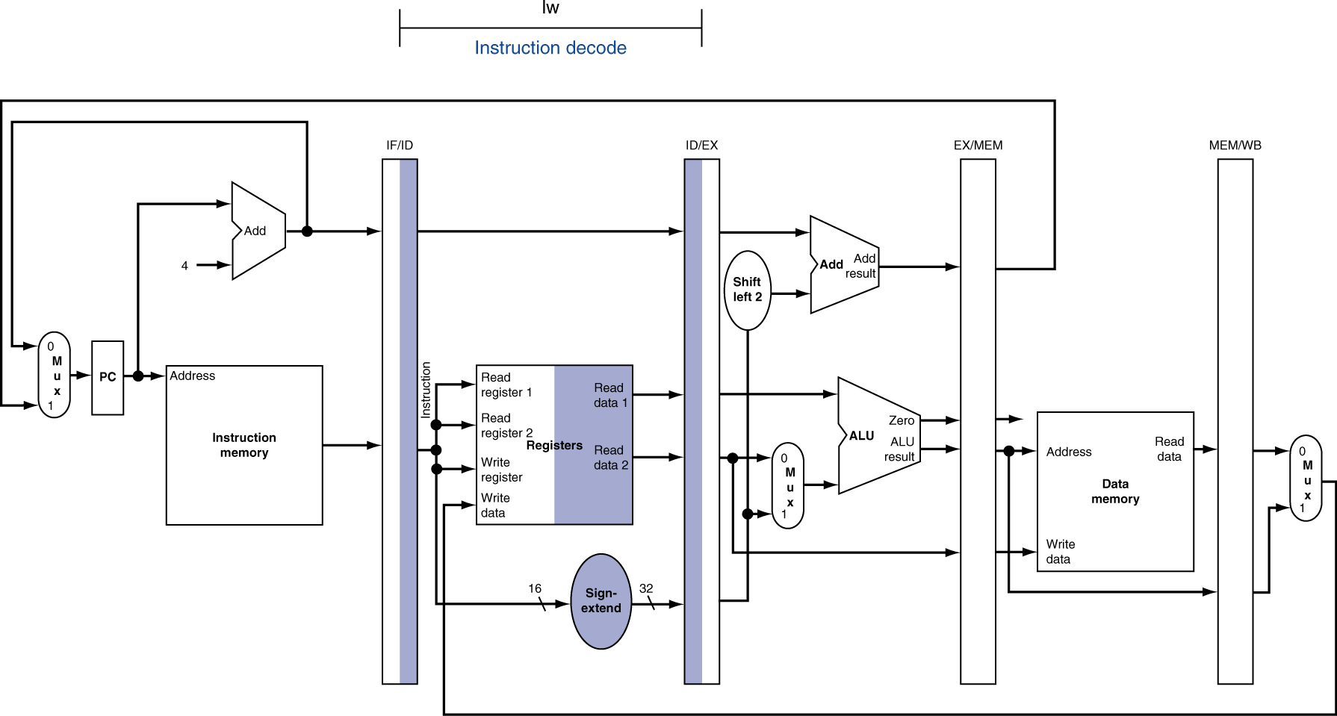
ID for Load

Slide 84
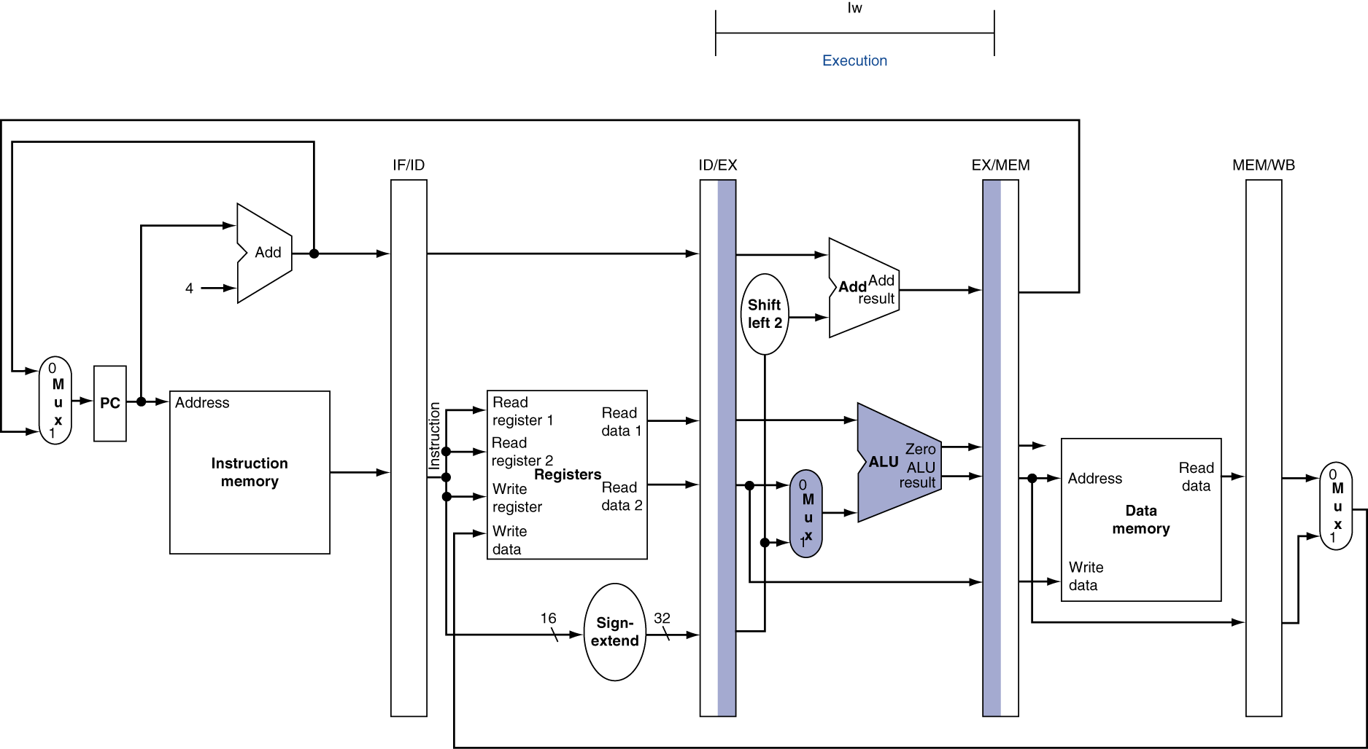
EX for Load

Slide 85
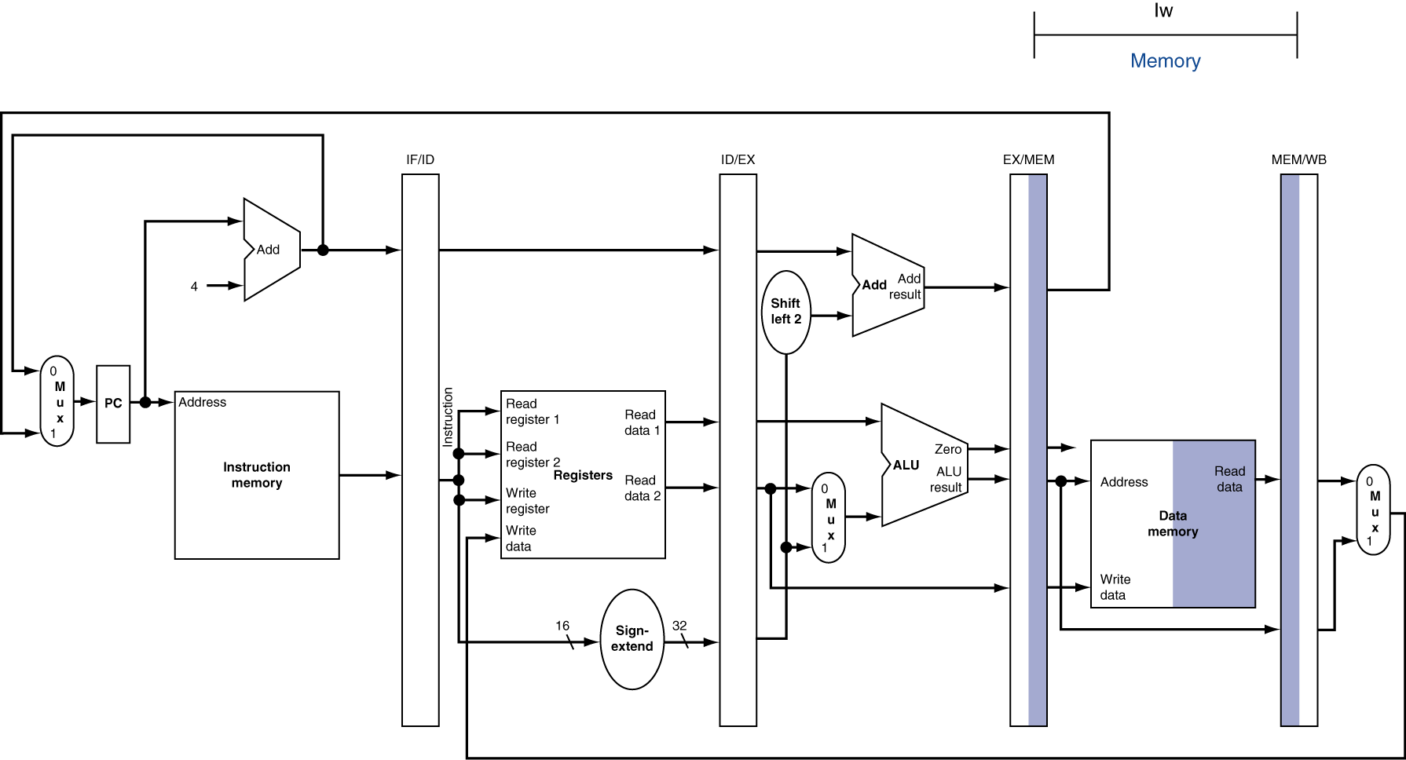
MEM for Load

Slide 86
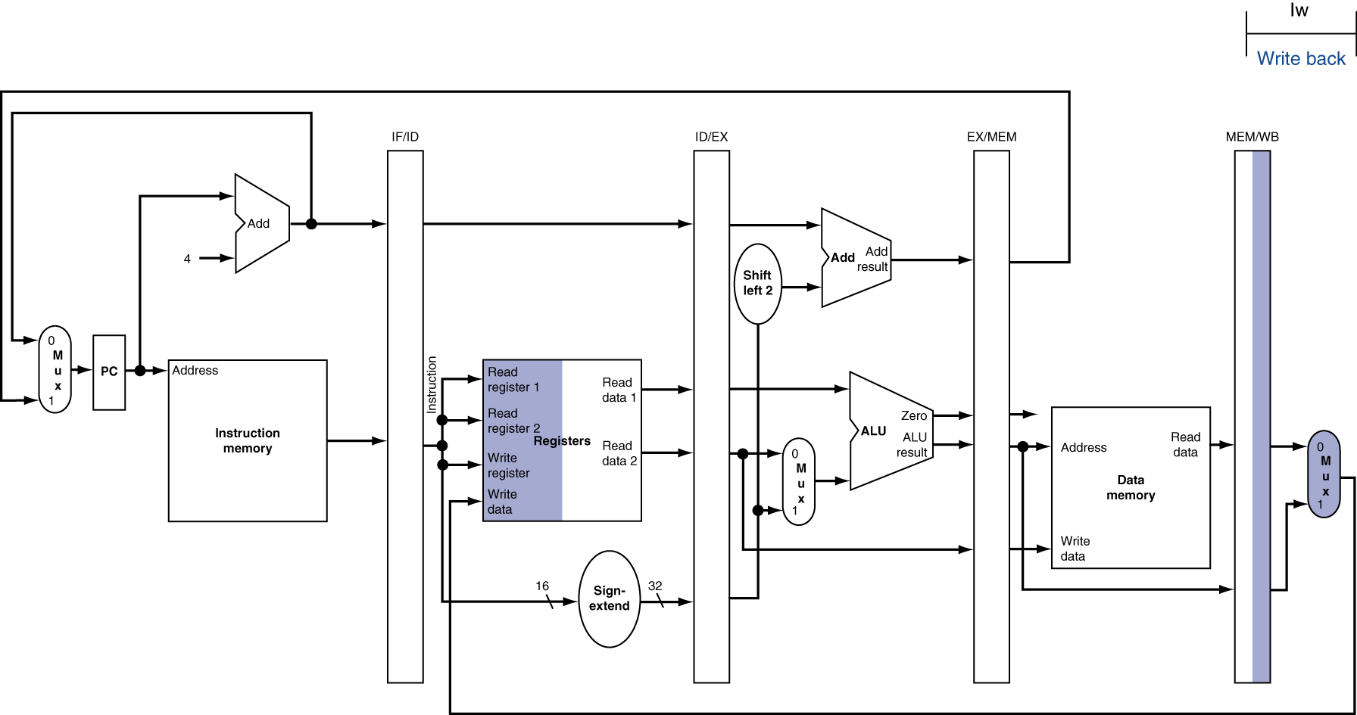
WB for Load
Wrong register number

Slide 87
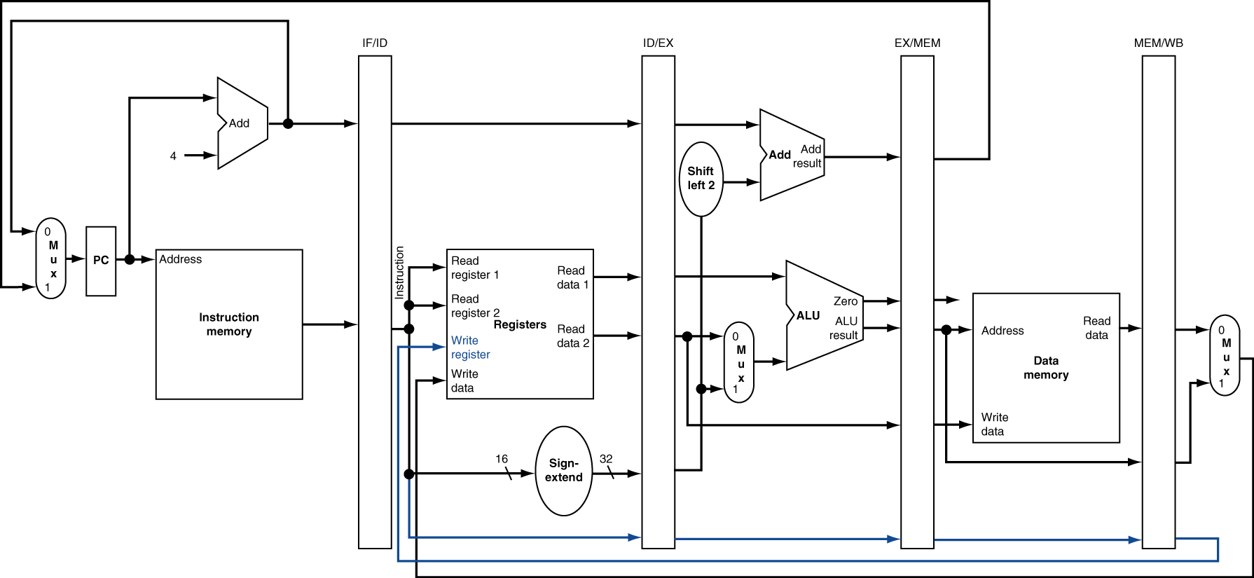
Corrected Datapath for Load

Slide 88
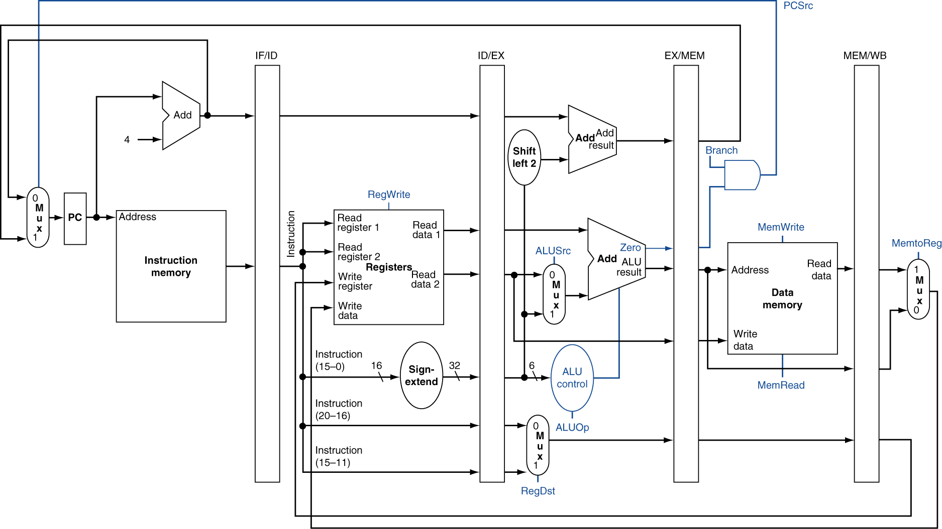
Pipelined Control

Slide 89
Pipelined Control
Instruction fetch:
PC written on every clock cycle
Instruction memory read on every clock cycle
no optional control lines
Instruction decode/register file read
Register file read on every clock cycle
no optional control lines
Execution:
Set RegDst: select the Result register
Set ALUOp: select the ALU operation
Set ALUSrc. select either Read data 2 or a sign-extended immediate for the ALU.
Memory access:
Set Branch: affects PCSrc
Set MemRead
Set MemWrite.
Write back:
Set MemtoReg: decides between sending the ALU result or the memory value to the register file
Set Reg-Write: specifies whether the register file can be written

Slide 90
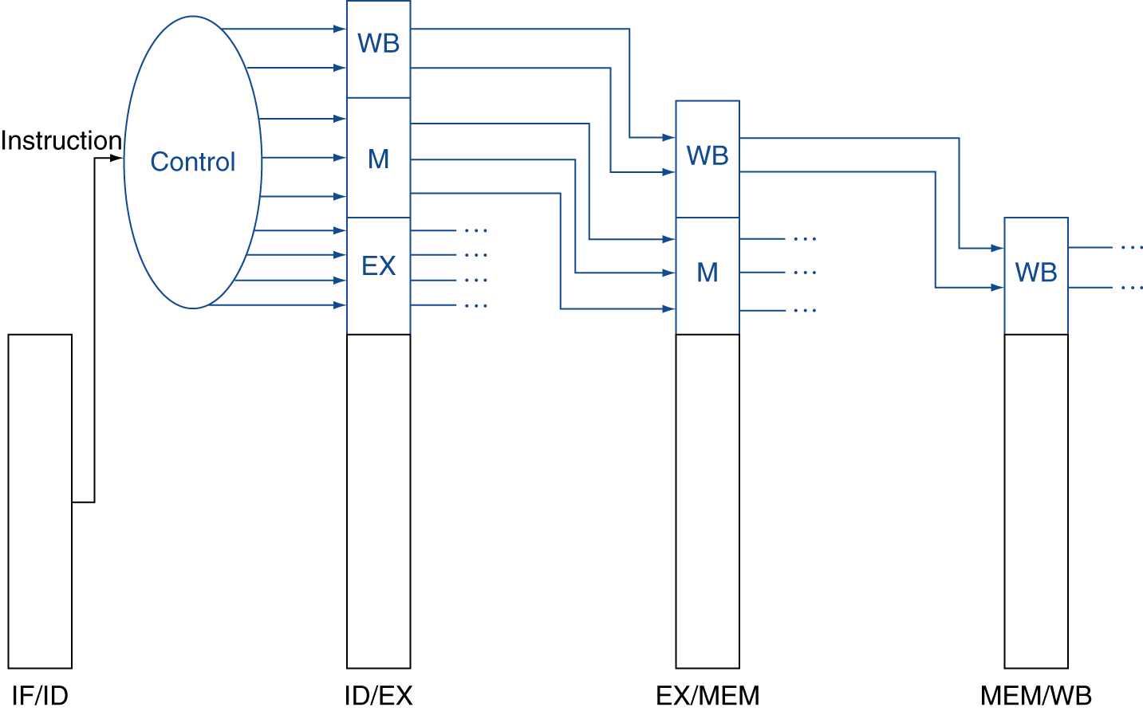
Pipelined Control
RegDst
ALUSrc
ALUOp1
ALUOp0
Branch
MemRead
MemWrite
MemtoReg
Regwrite

Slide 91
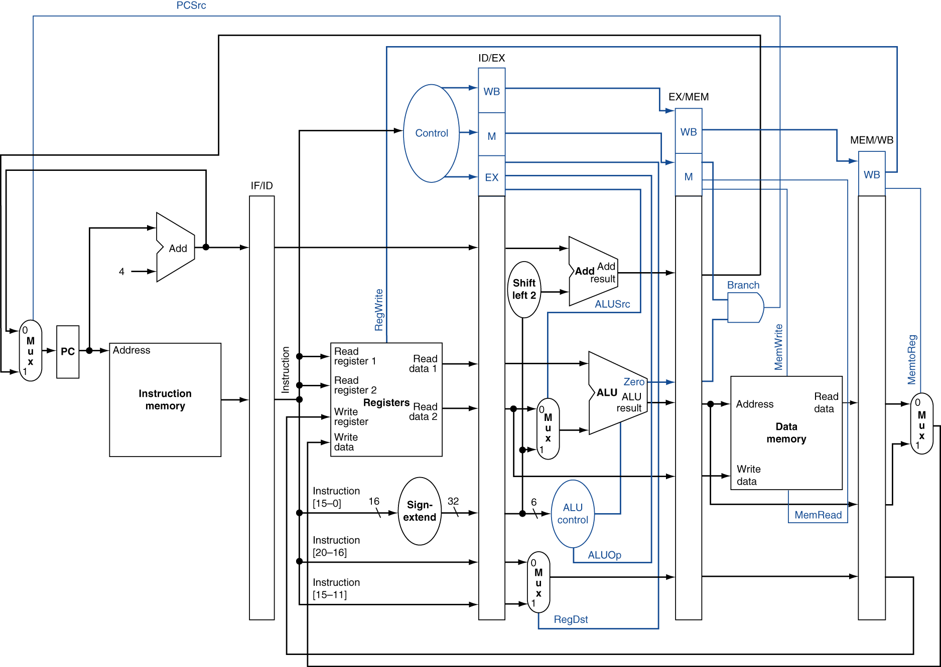
Pipelined Control

Slide 92
Hazards
Situations that prevent starting the next instruction in the next cycle
Structure hazard
A required resource is busy
Data hazard
Need to wait for previous instruction to complete its data read/write
Control hazard
Deciding on control action depends on previous instruction

Slide 93
Structure Hazards
Conflict for use of a resource
In MIPS pipeline with a single memory
Load/store requires data access
Instruction fetch would have to stall for that cycle
Would cause a pipeline “bubble”
Hence, pipelined datapaths require separate instruction/data memories
Or separate instruction/data caches

Slide 94
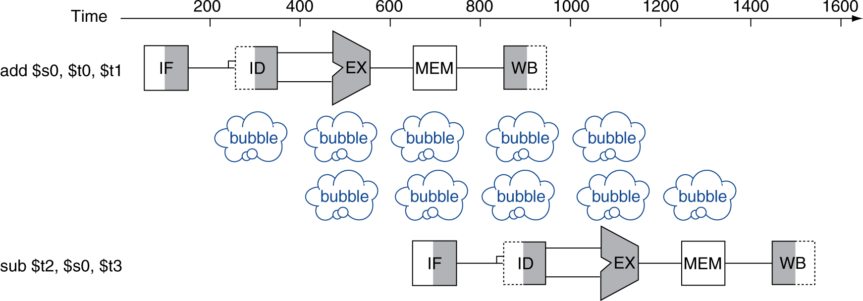
Data Hazards
An instruction depends on completion of data access by a previous instruction
add $s0, $t0, $t1
sub $t2, $s0, $t3

Slide 95
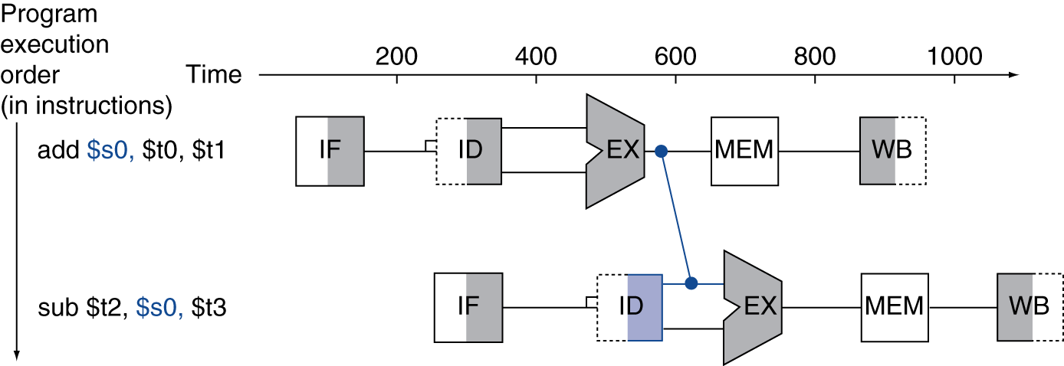
Forwarding (aka Bypassing)
Use result when it is computed
Don’t wait for it to be stored in a register
Requires extra connections in the datapath

Slide 96
Forwarding
Forwarding: the result is passed forward from an earlier instruction to a later instruction.

Slide 97
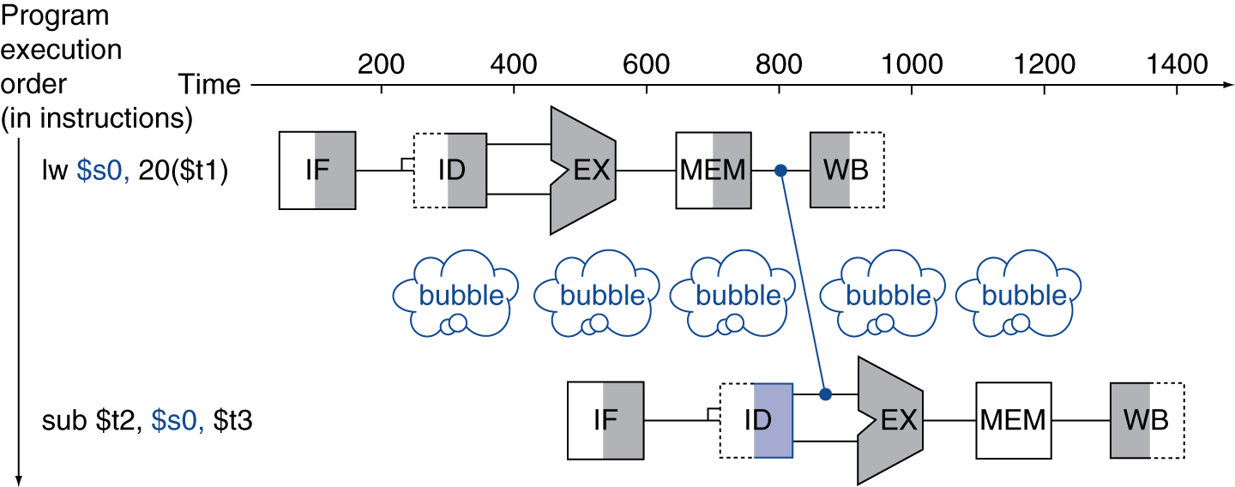
Load-Use Data Hazard
Can’t always avoid stalls by forwarding

Slide 98
Pipeline Stalls
A stall (bubble) is implemented with a nop
“No operation”
Force control values in ID/EX register to 0

Slide 99
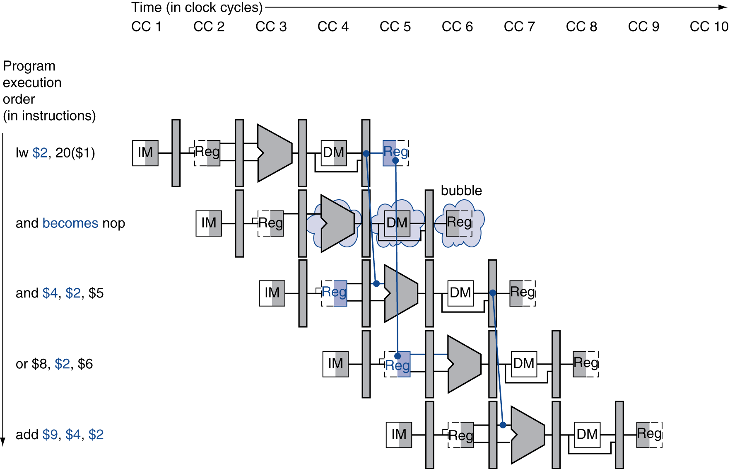
Stall/Bubble in the Pipeline
Stall inserted here

Slide 100
Code Scheduling to Avoid Stalls
Reorder code to avoid use of load result in the next instruction
C code for A = B + E; C = B + F;
lw $t1, 0($t0)
lw $t2, 4($t0)
add $t3, $t1, $t2
sw $t3, 12($t0)
lw $t4, 8($t0)
add $t5, $t1, $t4
sw $t5, 16($t0)
lw $t1, 0($t0)
lw $t2, 4($t0)
lw $t4, 8($t0)
add $t3, $t1, $t2
sw $t3, 12($t0)
add $t5, $t1, $t4
sw $t5, 16($t0)
stall
stall
13 cycles
11 cycles

Slide 101
Control Hazards
Branch Hazards
Branch determines flow of control
Fetching next instruction depends on branch outcome
Pipeline can’t always fetch correct instruction
Still working on ID stage of branch

Slide 102
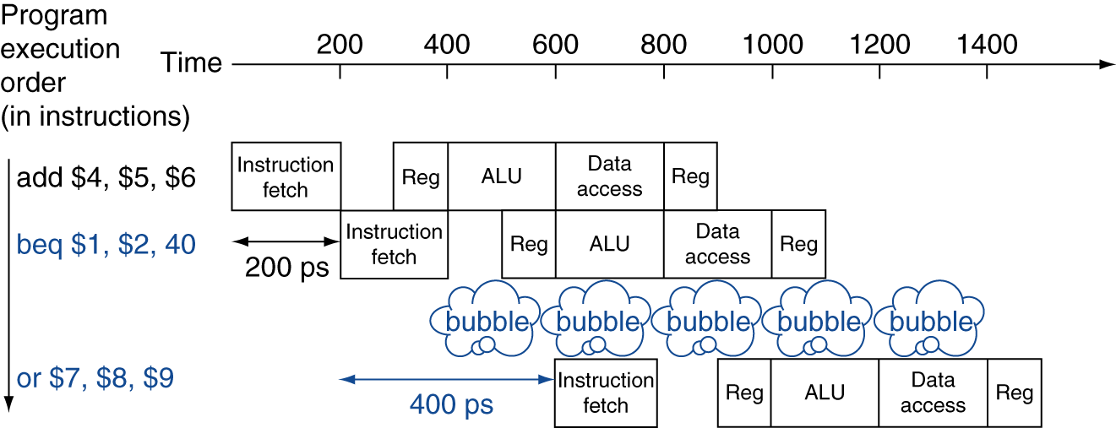
Stall on Branch
Wait until branch outcome determined before fetching next instruction

Slide 103
Branch Prediction
Longer pipelines can’t readily determine branch outcome early
Stall penalty becomes unacceptable
Predict outcome of branch
Only stall if prediction is wrong
In MIPS pipeline
Can predict branches not taken
Fetch instruction after branch, with no delay

Slide 104
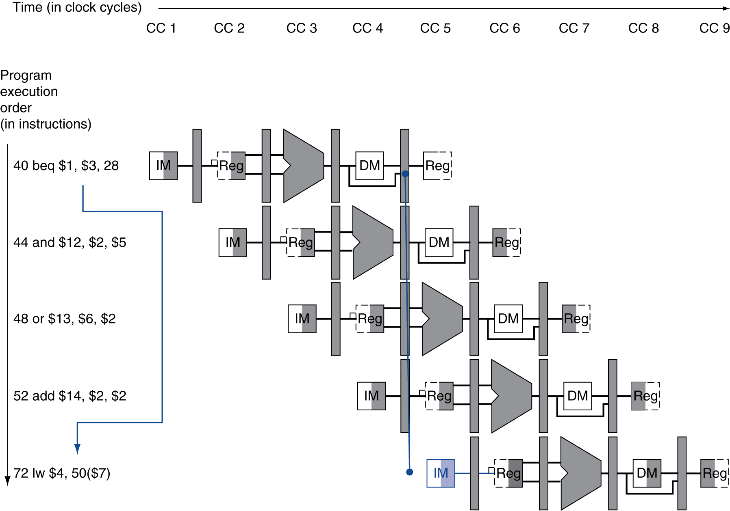
Predict Branch Not Taken
If branch is determined as taken in MEM:
Flush these instructions
(Set control values to 0)
PC

Slide 105
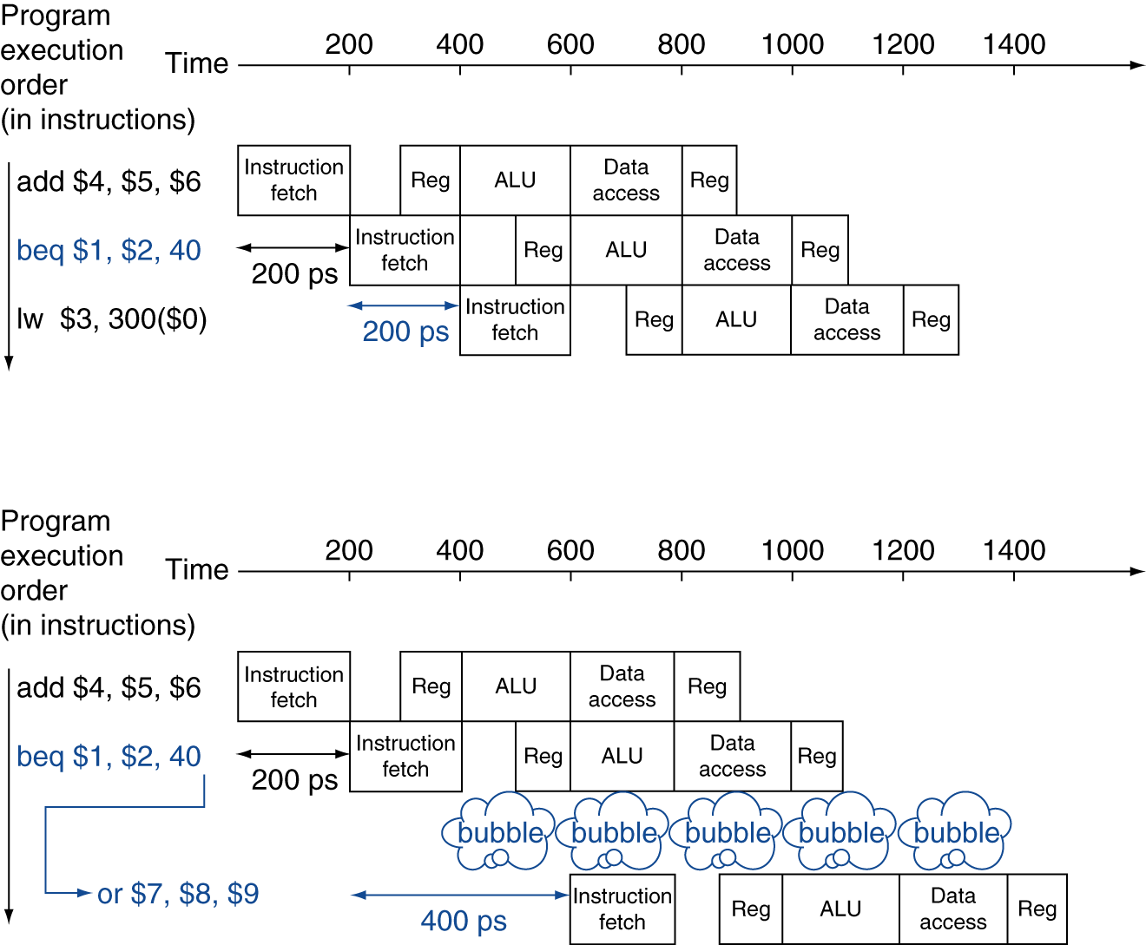
Predict Branch Not Taken
Prediction correct
Prediction incorrect

Slide 106
Predict Branch Not Taken
If branches are untaken half the time, and if it costs little to discard the instructions, this optimization halves the cost of control hazards.

Slide 107
Branch Prediction
Static branch prediction
Based on typical branch behavior
Example: loop and if-statement branches
Predict backward branches taken
Predict forward branches not taken

Slide 108
Dynamic Branch Prediction
In deeper and superscalar pipelines, branch penalty is more significant
Use dynamic prediction
Branch History Table
Indexed by recent branch instruction addresses
Stores outcome (taken/not taken)
To execute a branch
Check table, expect the same outcome
Start fetching from fall-through or target
If wrong, flush pipeline and flip prediction

Slide 109
1-Bit Predictor: Shortcoming
Inner loop branches mispredicted twice!
outer: … … inner: …
…
beq …, …, inner … beq …, …, outer
Mispredict as taken on last iteration of inner loop
Then mispredict as not taken on first iteration of inner loop next time around

Slide 110

2-Bit Predictor
Only change prediction on two successive mispredictions

Slide 111
Delayed Decision
Branch Instruction
Execute the next sequential instruction
Execute the instruction that resulted from the branch
add $4, $5, $6 -> beq $1, $2, 40
beq $1, $2, 40 -> add $4, $5, $6
<branch result> <branch result>

Slide 112
Cycle Time Matters
Delayed branches work when branches are short
no processor uses a delayed branch of more than 1 cycle
Longer branch delays rely on hardware based branch prediction

Slide 113
Reducing Branch Delay
Insight:
many branches rely only on simple tests
can be implemented with a few gates over an ALU
more complex branches take two instructions
slt followed by beq/bne
Move hardware to determine outcome to ID stage
Target address adder
Register comparator
Reduces the penalty of a branch to only one instruction if the branch is taken

Slide 114
Summary
Pipelining improves performance by increasing instruction throughput
Executes multiple instructions in parallel
Each instruction has the same latency
Subject to hazards
Structure, data, control
Instruction set design affects complexity of pipeline implementation

Slide 115
Exceptions and Interrupts
“Unexpected” events requiring change in flow of control
Exception
Arises within the CPU
Examples: undefined opcode, overflow, syscall
Interrupt
From an external I/O controller

Slide 116
Handling Exceptions
In MIPS, exceptions managed by a System Control Coprocessor (CP0)
Save PC of offending (or interrupted) instruction
In MIPS: Exception Program Counter (EPC)
Save indication of the problem
In MIPS: Status register
0000 – undefined instruction
0180 – arithmetic overflow
Jump to handler

Slide 117
An Alternate Mechanism
Vectored Interrupts
Handler address determined by the cause
Example:
Undefined opcode: C000 0000
Overflow: C000 0020
…: C000 0040
Instructions either
Deal with the interrupt, or
Jump to real handler

Slide 118
Handler Actions
Read cause, and transfer to relevant handler
Determine action required
If restartable
Take corrective action
use EPC to return to program
Otherwise
Terminate program
Report error using EPC

Slide 119
Exceptions in a Pipeline
Another form of control hazard
Consider overflow on add in EX stage
add $1, $2, $1
Prevent $1 from being overwritten
Complete previous instructions
Flush add and subsequent instructions
Set Cause and EPC register values
Transfer control to handler
Similar to mispredicted branch
Use much of the same hardware

Slide 120
Multiple Exceptions
Pipelining overlaps multiple instructions
Could have multiple exceptions at once
Simple approach: deal with exception from earliest instruction
Flush subsequent instructions

Slide 121
Fallacies
Pipelining is easy
The basic idea is easy
The devil is in the details
e.g., detecting data hazards
Pipelining is independent of technology
So why haven’t we always done pipelining?
More transistors make more advanced techniques feasible
Pipeline-related ISA design needs to take account of technology trends

Slide 122
Pitfalls
Poor ISA design can make pipelining harder
e.g., complex instruction sets (VAX, IA-32)
Significant overhead to make pipelining work
e.g., complex addressing modes
Register update side effects, memory indirection
e.g., delayed branches
Advanced pipelines have long delay slots

Slide 123
Concluding Remarks
ISA influences design of datapath and control
Datapath and control influence design of ISA
Pipelining improves instruction throughput
More instructions completed per second
Latency for each instruction not reduced
Hazards: structural, data, control
Exceptions are handled by a outside handler and control hazard logic.

